Slide 1
Effective Reflection

Slide 2
Detachment
Sources
Methods

Slide 3
Detachment
Notes:
Opposite: attachment
Lethargy is not detachment
- detachment is the ability to set aside one's ego, personal agenda
How do we develop detachment?
- crisis
- introspection / self-awareness
- practice!

Slide 4
Purpose of Reflection
Notes:
Ask the group to offer ideas about this.
Purpose: to connect our action to learning. Reflection allows us to systematically observe what happened. These observations become the basis for our learning.
Happens at the start of every Cycle – but reflection looks into the past cycle (and possibly even further back).
Also known as: post-mortems, debriefings, retrospectives, assessment, and project reviews.

Slide 5
What to Observe?
Tools and technology
Work space
Corporate culture
Teamwork
Work planning and execution
Skill sets
Interpersonal dynamics
External groups
Personal circumstances
The process itself
Events and activities
Financials
Results
Feelings
Gaps
Changes in the Cycle Plan
Crises
Victories
The unexpected happening
The expected not happening
Notes:
This is not a complete list
Observation is not about drawing conclusions... relate to the scientific method, connect back to consultative decision making (results of unified action will lead to stuff to observe... also if action is not unified!)

Slide 6
The Rules of Reflection
Notes:
Process Facilitator
Part of Cycle Planning
Part of Progress Meetings
Not Optional!
Should be noted:
- not timeboxed by itself (only as part of overall Cycle Planning)
- no specific method advised: depends on needs of team/organization
Reflection can also happen at other times – detachment and articulation of observations is useful in any consultative decision making.

Slide 7

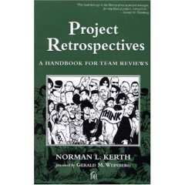
References
www.retrospectives.com

Slide 8
O
Notes:
Any questions or comments?

